Slide 1

12/20/2024
Project
Patient Mortality Prediction
Names:Austin,Hanane,Natalie
Notes:
Natalie
Hello everyone! Today, we are presenting our project on Patient Mortality Prediction.
Our group members are Austin, Hanane, and Natalie.

Slide 2
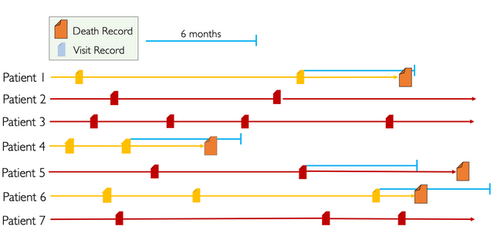
Our Project
Our project is based on the EHR Dream Challenge 2019 organized by the University of Washington and Sage Bionetworks
We developed an end-to-end machine learning pipeline to build and evaluate machine learning models on EHR data.
Task: We used EHR data to
predict mortality within 180 days
after the last visit
True positives: Patients who pass away within 180 days
True negatives: Patients who:
Have not passed away
Passed away more than 180 days after their last visit
Notes:
Natalie
Our project is based on the EHR Dream Challenge 2019, which was organized by the University of Washington and Sage Bionetworks.
This challenge focuses on leveraging Electronic Health Records (EHR) to develop predictive models for healthcare-related outcomes.
predict whether a patient will pass away within 180 days after their last available medical visit.
Definitions
True Positives (TP):
These are patients who actually passed away within 180 days of their last visit and were correctly identified by our models.
Patient one
True Negatives (TN):
These include patients who either:
Did not pass away at all, (patient 3)
Passed away more than 180 days after their last visit (patient 5)

Slide 3
STEP 1
PATIENT MORTALITY PREDICTION PROJECT
Data Exploration
Dataset: Synthetic EHR dataset (Synpuf), formatted in the OMOP Common Data Model
Data files: 7 tables each for training, testing & 6 concept codes tables
Visit_occurence, person, observation, observation_period, drug_exposure, death, condition_occurrence
Started with training data files
Examined dimensions, column names, missingness
Merge table with corresponding concept code file on concept_id
Count frequency of each unique concept_name
Applied same code to testing files
Notes:
Natalie
Understand data, how it was organized
The dataset is formatted in the OMOP Common Data Model, which is a standardized format for storing health data.
The dataset consists of 7 tables for both the training and testing sets.
Additionally, there are 6 concept code tables that provide meaningful descriptions for various codes in the EHR data.
We began by examining the training data tables to understand their structure and content.
For each table, we checked the dimensions (number of rows and columns), column names, and the extent of missing data.
Merge table with corresponding concept code file on concept_id - This allowed us to replace numeric codes with their human-readable names
We counted the frequency of each unique concept_name to identify important categories (e.g., common conditions or drug types)
After processing the training data, we applied the same steps to the testing data files to ensure consistency.

Slide 4
STEPS 2
PATIENT MORTALITY PREDICTION PROJECT
DATA MERGING AND FEATURE EXTRACTION
Final Table
Patient
Table1
Death
Table2
Conditions
Table3
Observation
Table 4
Drugs
Table 5
Merged our patient with patient concept to get Demographics such as age, gender and race.
Selected and grouped few important conditions and created a column for each condition
We extracted our Outcome Variable by calculating the Last visit date and Death date if available
Extracted high risk admission type
Selected and grouped a few important Drugs
Notes:
Natalie
Read slide

Slide 5
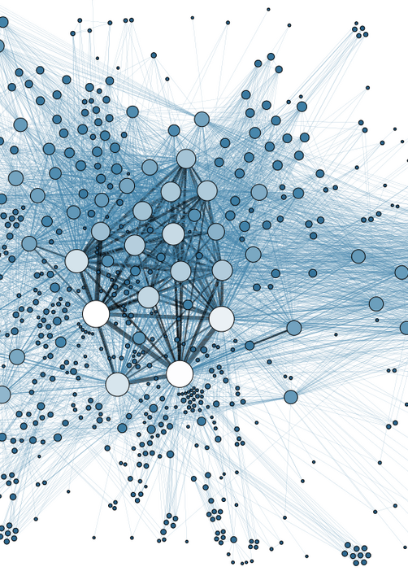
Features
Outcome
Features and Outcome
Demographics (Age, Gender, Race)
Conditions
High-risk Admission Type
High-risk Drugs
Death classification
Notes:
Natalie
Main groups of features

Slide 6
PATIENT MORTALITY PREDICTION PROJECT
Our Final Table
Age | Gender | Race | Conditions | High-Risk Drugs | High-Risk Admission Type | Outcome (Death classification)
Continuous | Binary | Binary | Binary | Binary | Binary | Binary
1 feature | 2 features: gender_NAN, gender_Male | 6 features: race_Asian, race_AA, race_PI, race_U, race_White, race_NAN | 5 features: Cerebrovascular Disease, Congestive Heart Failure, End-Stage Disease, Myocardial Infarction, Peripheral Vascular Disease | 3 features: cancer_drug, Palliative_care drug, serious disease drug | 1 feature | 1 feature
race_AA = race_Black or African American
race_PI = race_Native Hawaiian or Other Pacific Islander
race_U = race_Unknown
Notes:
Natalie
Final feature table

Slide 7
CYMBAL
PRODUCT OVERVIEW
Applying different machine learning algorithms
PATIENT MORTALITY PREDICTION PROJECT
Notes:
natalie

Slide 8
PATIENT MORTALITY PREDICTION PROJECT
Feature Selection:
Investigating if a smaller set of relevant features improve performance as opposed to using all features
Group 2: Conditions + Demographics
Cerebrovascular Disease
Congestive Heart Failure
End-Stage Disease
Myocardial Infarction
Peripheral Vascular Disease
+ Demographics
Group 3: Full Matrix
Cancer_drug
Palliative_care_drug
Serious_disease_drug
High_risk_admission
+ Conditions
+ Demographics
Group 1: Demographics
Age
Gender
Race
Notes:
Austin

Slide 9
Evaluation of the Models
PATIENT MORTALITY PREDICTION PROJECT
Logistic Regression Precision: 0.01 Recall: 0.59 F1-score: 0.02 AUC-ROC: 0.683 | Random Forest Precision: 0.01 Recall: 0.35 F1-score: 0.02 AUC-ROC: 0.606
First Model
Logistic Regression Precision: 0.01 Recall: 0.53 F1-score: 0.02 AUC-ROC: 0.662 | Random Forest Precision: 0.01 Recall: 0.24 F1-score: 0.02 AUC-ROC: 0.563
Second Model
Logistic Regression Precision: 0.01 Recall: 0.53 F1-score: 0.02 AUC-ROC: 0.657 | Random Forest Precision: 0.01 Recall: 0.16 F1-score: 0.02 AUC-ROC: 0.542
Third Model
Notes:
Austin

Slide 10
Difference
Best Performing
Worst Performing
Precision: 0.01
Recall: 0.59
F1-score: 0.02
AUC-ROC: 0.683
PATIENT MORTALITY PREDICTION PROJECT
Group 1: Demographics
Model: Logistic Regression
Group 3: Full Matrix
Model: Random Forest
Precision: 0.01
Recall: 0.16
F1-score: 0.02
AUC-ROC: 0.542
Notes:
Austin

Slide 11
RESULTS
Our analysis and modeling efforts provided the following key insights:
PATIENT MORTALITY PREDICTION PROJECT
Precision: Remained consistent across all models at 0.01
This indicates a significant challenge in correctly identifying positive cases without also including false positives.
Recall: Logistic Regression consistently achieves higher recall (0.53–0.59) than Random Forest across all models.
This suggests moderate performance but leaves room for improvement to ensure more positive cases are identified.
F1-Score: Remained consistently low across all models (0.02)
Reflects the challenges of balancing precision and recall due to class imbalance.
AUC-ROC: Logistic Regression consistently outperforms Random Forest in AUC-ROC across all three models.
The best performance observed for Group 1 (Demographics) features at 0.683.
Notes:
Hanane

Slide 12
CYMBAL
PRODUCT OVERVIEW
Hyperparameter Tuning
PATIENT MORTALITY PREDICTION PROJECT
Notes:
Austin

Slide 13

Improving Random Forest Model Performance
Hyperparameter Tuning Process:
Method Used: GridSearchCV (5-fold cross-validation)
Why GridSearchCV?
GridSearchCV systematically evaluates all possible combinations of hyperparameters within a predefined grid.
Goal of Tuning: Optimize AUC-ROC
Scoring Metric: AUC-ROC
Tuned Parameters:
n_estimators: [100, 200] (Number of trees in the forest)
max_depth: [10, 20] (Maximum depth of trees)
min_samples_split: [2, 5] (Minimum samples required to split a node)
min_samples_leaf: [1, 2] (Minimum samples at a leaf node)
max_features: ['sqrt'] (Number of features to consider for splitting)
Notes:
Austin

Slide 14
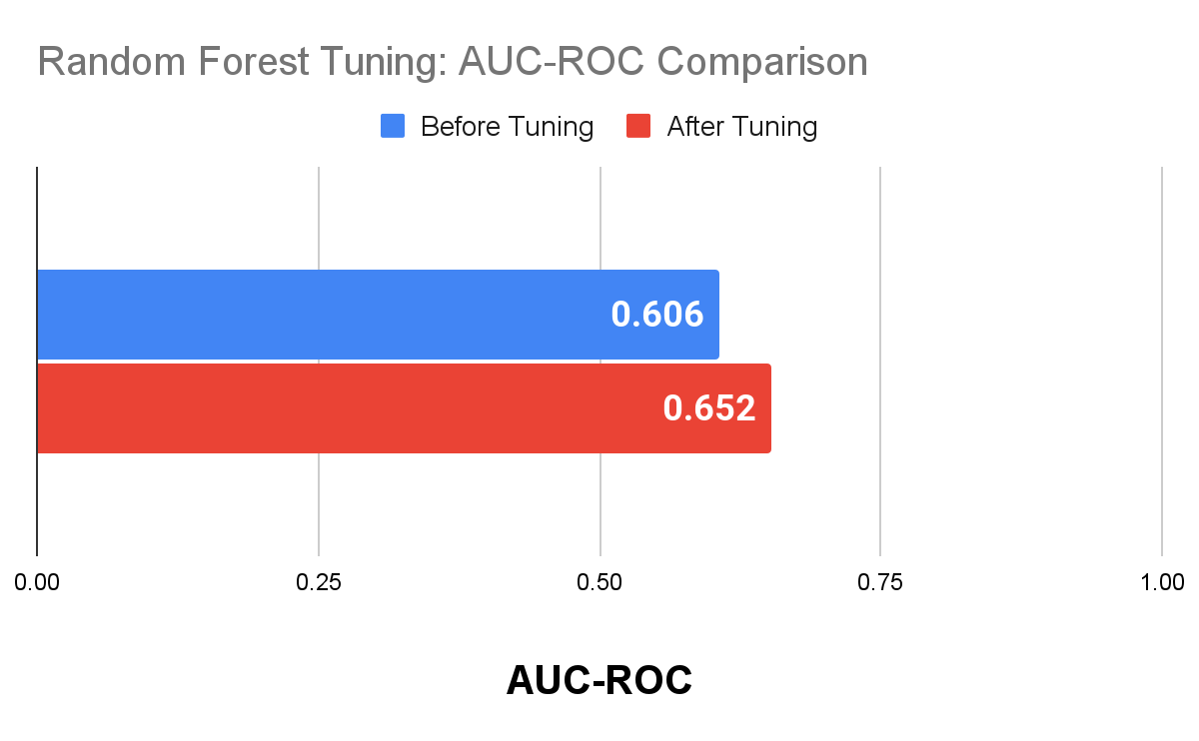
Post-Tuning Model Performance
After Tuning:
AUC-ROC
measures the model's ability to distinguish between classes
Model Performance
AUC-ROC Improved from 0.606 -> 0.652
Performance Gain: 7.6% increase!
Why It Improved: Adjusting the model to limit overfitting (by reducing tree depth and requiring more samples per split) improved generalization, boosting AUC-ROC on the test set.
Notes:
Austin max_depth: Reducing the maximum depth of the trees (e.g., to 10 or 20) prevents the model from growing excessively deep trees. Shallow trees are less likely to memorize specific data points and noise, thereby reducing overfitting. min_samples_split: Increasing the minimum number of samples required to split a node (e.g., from 2 to 5) ensures that splits only happen when there’s enough data to justify it. This reduces the likelihood of creating overly specific rules for small subsets of data, which can lead to overfitting. min_samples_leaf: By requiring at least 1 or 2 samples at the leaf nodes, the model avoids creating leaf nodes for outliers or very small subsets of the data, which can lead to poor generalization. max_features ('sqrt'): Limiting the number of features considered for splitting at each node ensures that splits are based on a subset of the features, introducing randomness and diversity in the trees. This reduces the correlation between individual trees and improves the ensemble’s ability to generalize.

Slide 15
CYMBAL
PRODUCT OVERVIEW
CONCLUSION
PATIENT MORTALITY PREDICTION PROJECT

Slide 16
Performance Limitations:
PATIENT MORTALITY PREDICTION PROJECT
Across all models, precision and F1-scores were consistently low (0.01-0.02), indicating significant difficulty in correctly identifying positive cases without misclassification.
Logistic Regression achieved the best overall performance, particularly when limited to demographic features (AUC-ROC: 0.683), outperforming Random Forest.
A major obstacle in this study was the dataset class imbalance, leading to biased predictions and misclassification errors.
Reasons for Class Imbalance:
Real-World Distribution of Mortality: Mortality is often a rare event, leading to a natural class imbalance in the dataset.
Dataset Characteristics: The way the data was generated might not have evenly represented the classes.
Small Population of High-Risk Cases: The conditions we selected are more rare. Patients with high-risk factors contributing to mortality may represent a even smaller fraction of the data
Notes:
Hanane

Slide 17
Potential Improvements
PATIENT MORTALITY PREDICTION PROJECT
Address Class Imbalance: Use methods like SMOTE, under-sampling, or weighted adjustments to make the dataset more balanced.
Improve Features: Create better features by transforming or combining existing data for better representation.
Exploring more features: for example: interaction between age and high-risk conditions.
Model Optimization: Use advanced algorithms like Gradient Boosting Machines or Ensemble Models to better capture complex relationships in the data.
Version Control Conflicts: Implement GitFlow branching strategies to reduce conflicts and improve collaboration.
RAM constraints in Google Colab : as we trained models with more and more features and off larger data sets it becomes more imperative to switch to a cloud-based environments like AWS SageMaker, GCP AI Platform…
Notes:
Hanane
SMOTE: is a data augmentation technique that generates synthetic samples for the minority class to balance the dataset.
Under Sampling: This method reduces the size of the majority class by randomly removing instances, bringing it closer to the size of the minority class.
Weighted Adjustments: assign higher importance (or weights) to the minority class.
Gradient Boosting Machines: it builds models one after the other, where each model attempts to correct the errors of the previous ones.

Slide 18
THANK YOU
Questions?

